Slide 1
Data Curation Project
By-
Akshay, Kruthi, Nikhil
Group 2

Slide 2
Data Set
We took a dataset flights available on Kaggle
The dataset had 297951 total observations.
The problems in the data set are are non-uniformly distributed to certain columns
There are ~2% missing values in the dataset

Slide 3
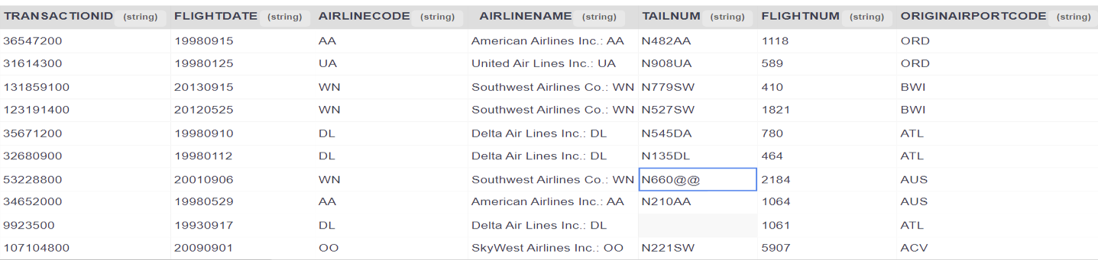
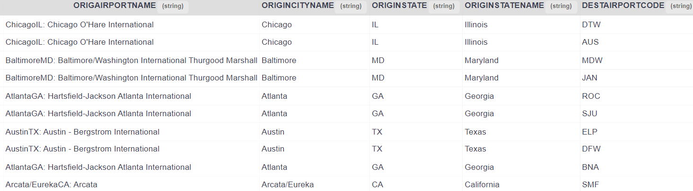
Loading Dataset

Slide 4
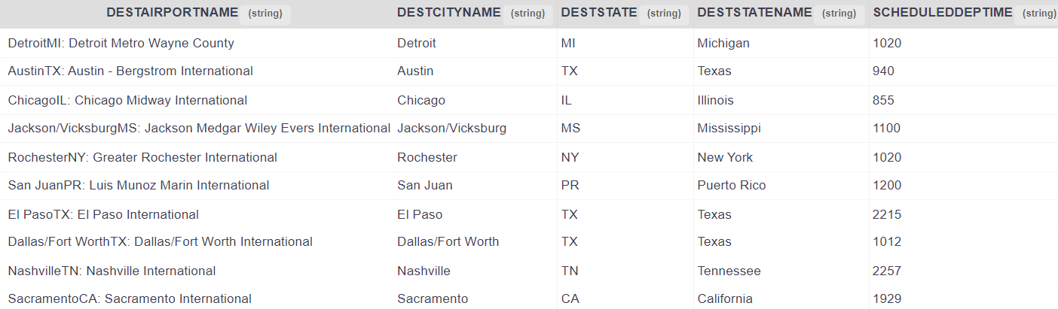
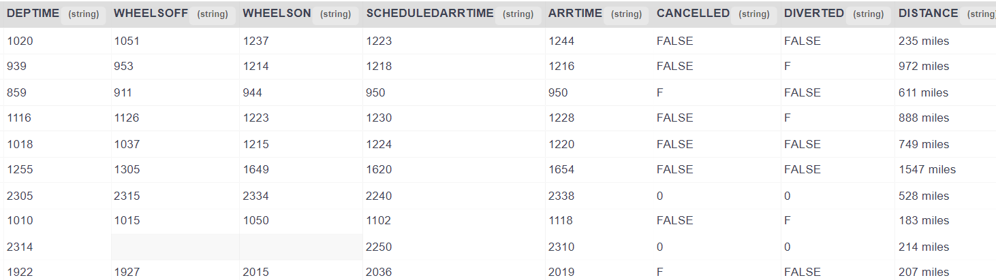
Loading Dataset

Slide 5
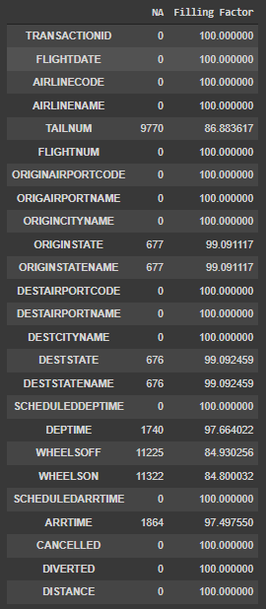
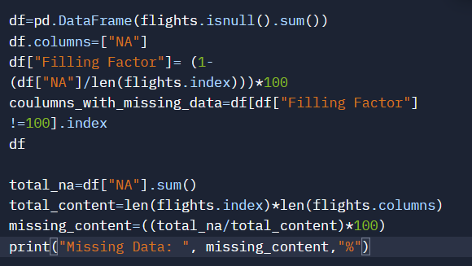

Missing Data

Slide 6
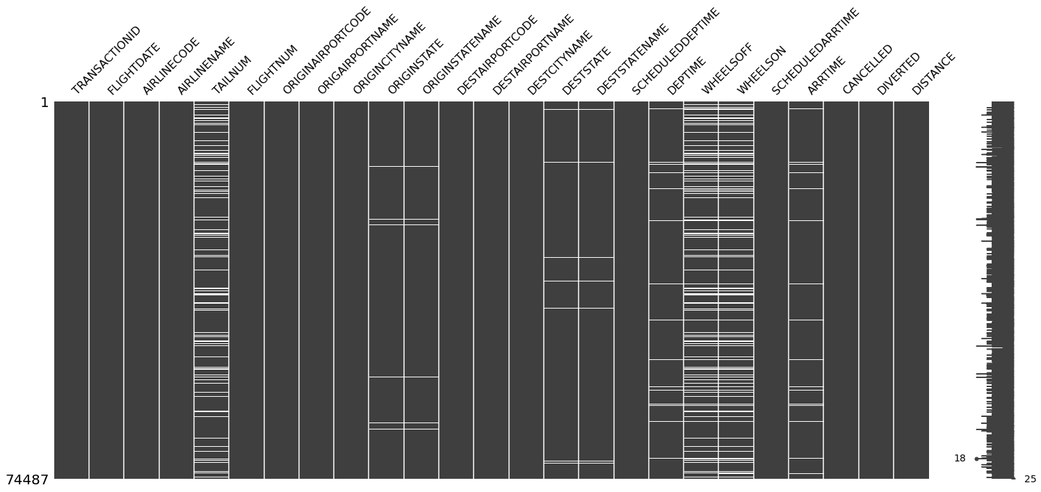
Missing Data

Slide 7
Problems
FLIGHTDATE is a int. Should be a date object in format(YYYY/MM/DD)
AIRLINENAME has the airline code concatenated with the airline name
TAILNUM has the '@' symbol in some of the rows.
ORIGINAIRPORTNAME and DESAIRPORTNAME have both the state and city concatenated with the airport name

Slide 8
Problems
SCHEDULEDDEPTIME, DEPTIME, WHEELSOFF, WHEELSON, SCHEDULEDARRTIME, and ARRTIME all are times as integer format. This is in 24 hour format.
CANCELLED and DIVERTED columns have several values which denote false. It can be assumed that when a value is true we will encounter similar errors.
DISTANCE is a string with " miles" concatenated onto the numerical value

Slide 9
Addressing The Problems

Slide 10
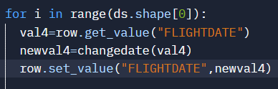
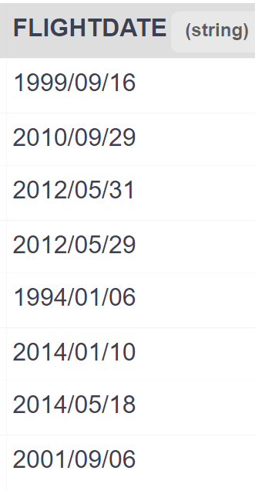
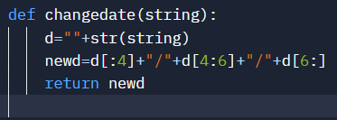
Problem 1: Flight Date
We converted the given date in integer as YYYYMMDD to string YYYY/MM/DD

Slide 11
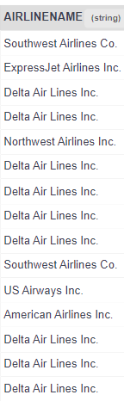
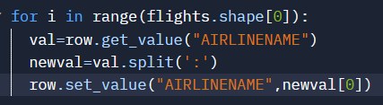
Problem 2 : Airline Name
Airline name has airline code concatenated with it

Slide 12
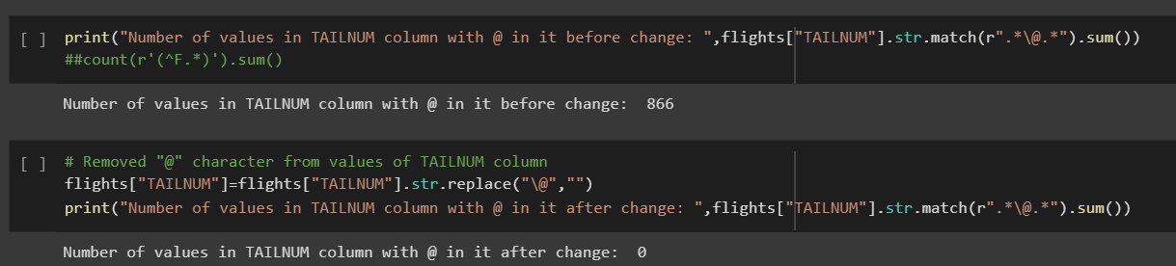
Problem 3: Tailnum
The tail number of aircraft has @@ present at the end in few rows.

Slide 13
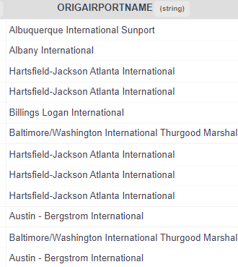
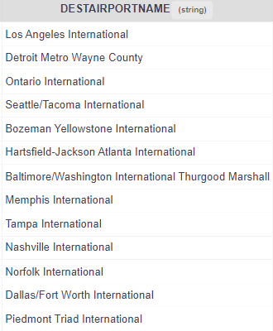
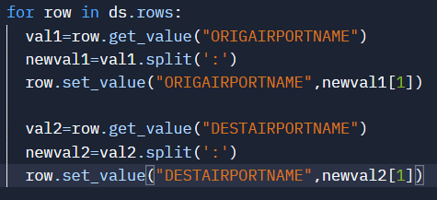
Problem 4: Origin/Destination Airport
Origin airport name and destination airport have both the state and city concatenated with the airport name

Slide 14

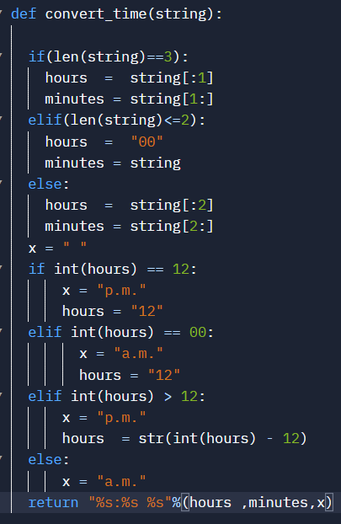
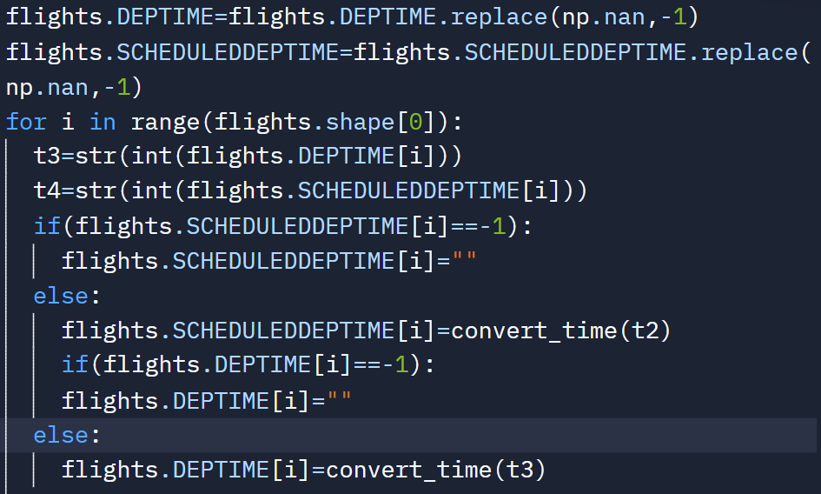
Problem 5: Departure Time/Scheduled Departure Time
We converted the given time in integer as XXXX to string HH:MM XX

Slide 15
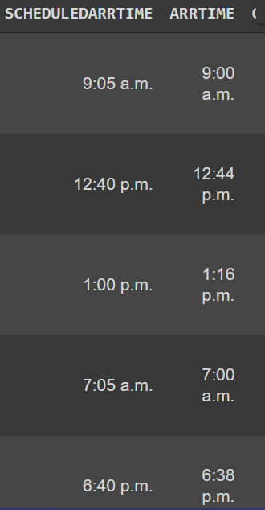
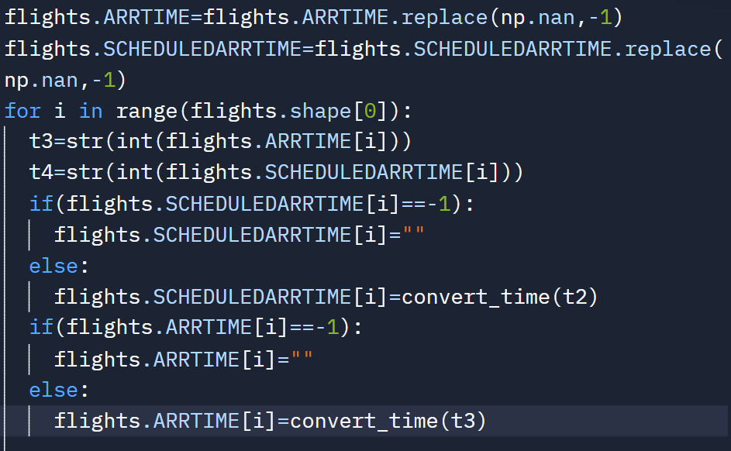
Problem 5: Arrival Time/Scheduled Arrival Time
We converted the given time in integer as XXXX to string HH:MM XX

Slide 16
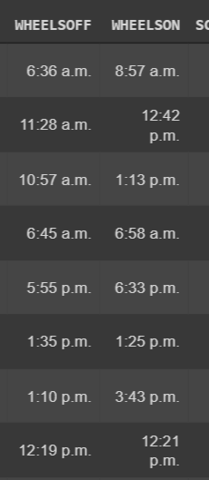
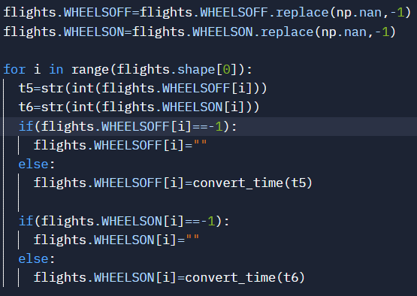
Problem 5: Wheel on/off Time
We converted the given time in integer as XXXX to string HH:MM XX

Slide 17
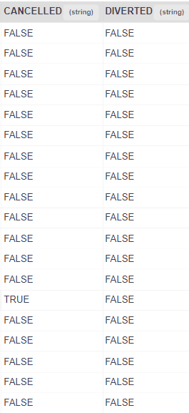
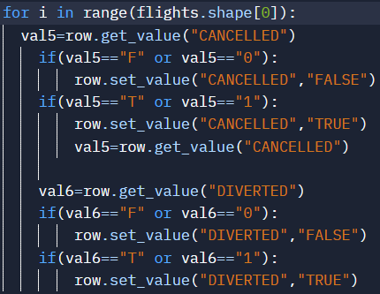
Problem 6: Cancelled/Diverted
Cancelled and Diverted Column has inconsistencies
False is represented as False, F, 0
True is represented as True ,T, 1

Slide 18
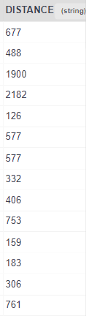
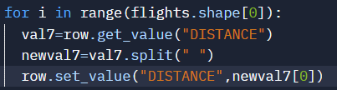
Problem 7: Distance
Distance has miles concatenated at the end

Slide 19
Addressing the Missing Data

Slide 20
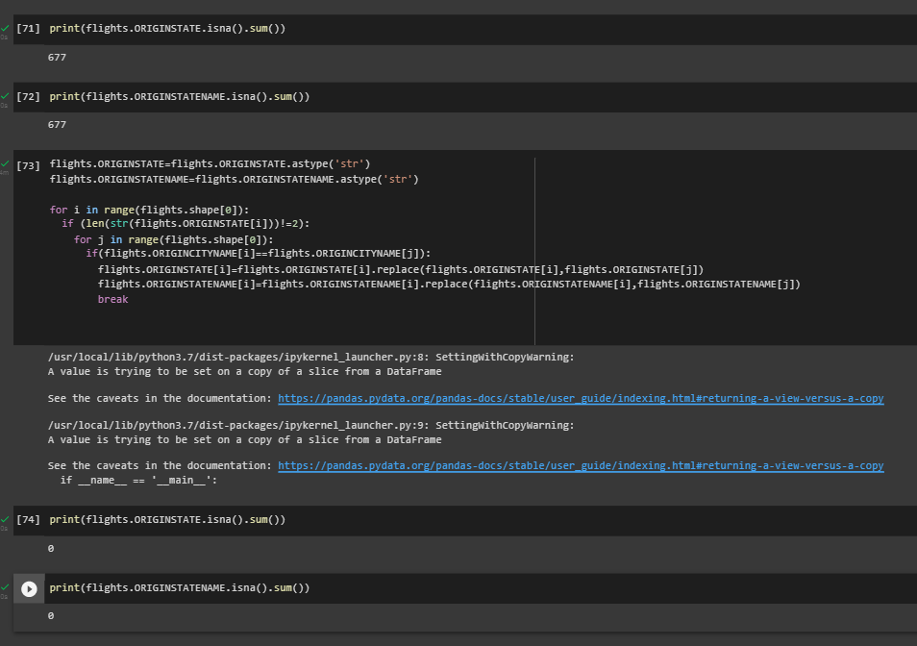
Origin State / Origin State Name
To fix the missing values in the above two columns we have compared city name of the column with issue to other city name where column are not null and replaced the null values by correct values

Slide 21
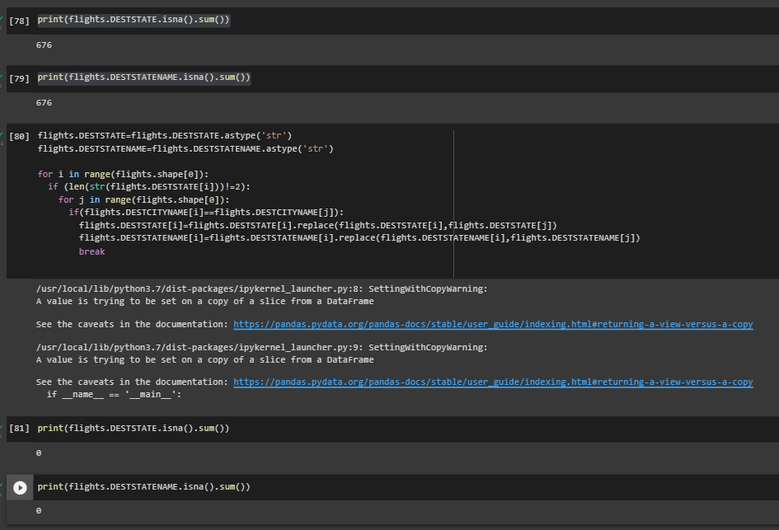
Destination State / Destination State Name
To fix the missing values in the above two columns we have compared city name of the column with issue to other city name where column are not null and replaced the null values by correct values

Slide 22
Challenges Still To Address
The Data Missing In Actual Arrival/Departure Time cannot be calculated as it may lead to inconsistency and wrong values may be calculated by available techniques.
Few Aircrafts have tail number missing, that cannot be fixed as a certain aircraft has fixed Tailnum and that cannot be computed by available techniques

Slide 23
Visualization of Data

Slide 24
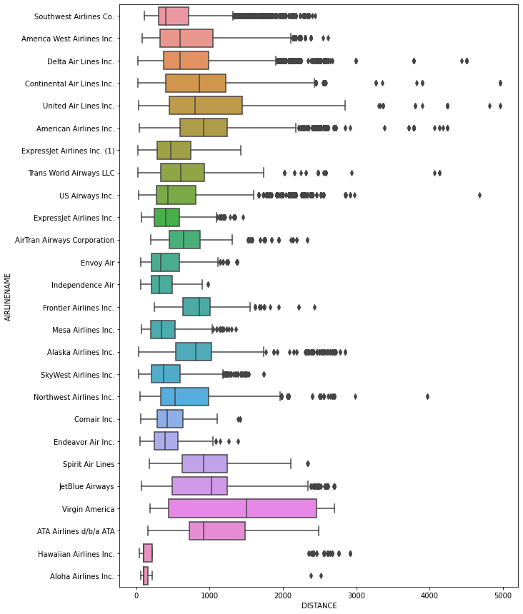
Box-Plot of flight
Distance

Slide 25
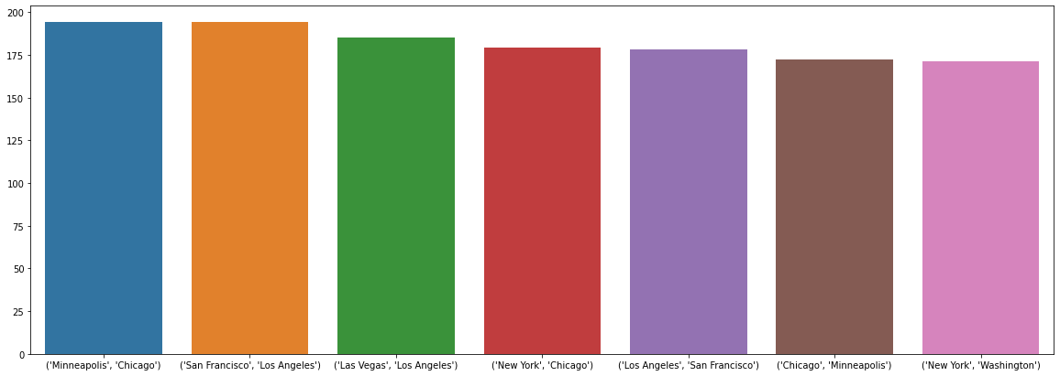
Cities with most flights

Slide 26
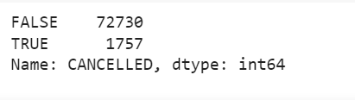
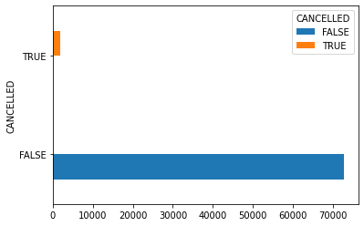
Total Flights Cancelled
Total flights = 74487
% Flights Cancelled = 2.35%

Slide 27
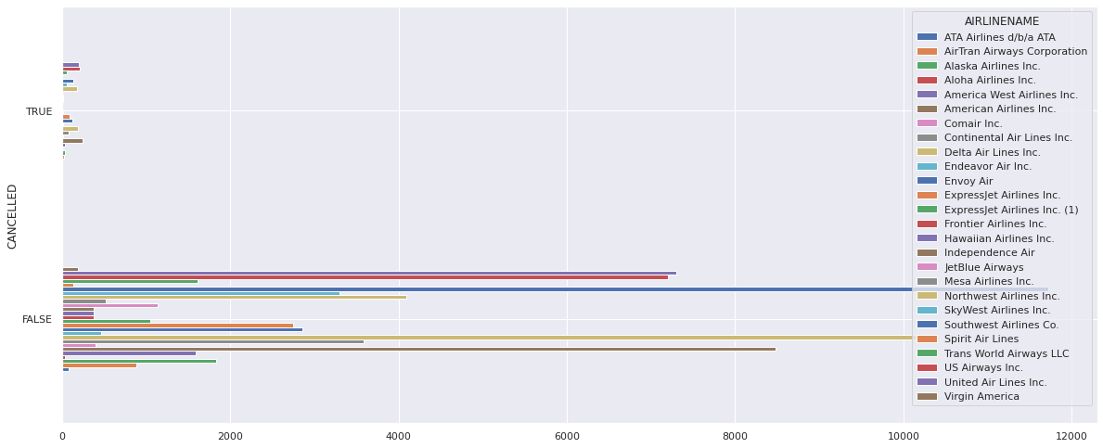
Total Cancelled Flights per Airline

Slide 28
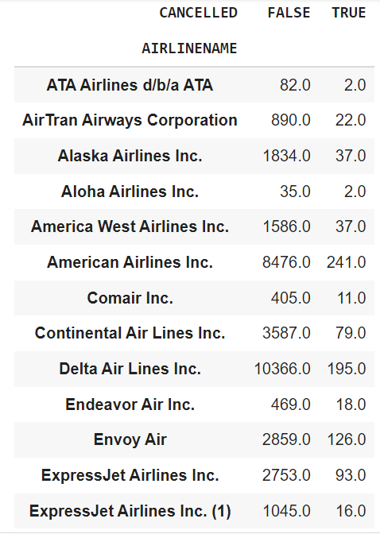
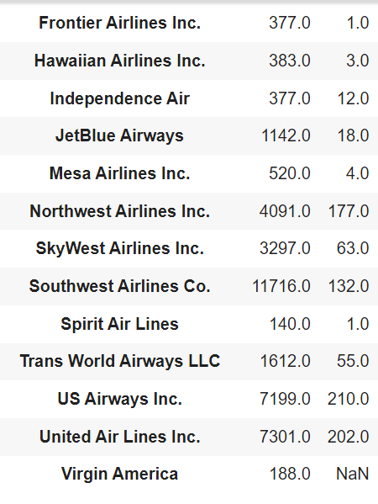
Cancelled Flights per Airline Table

Slide 29
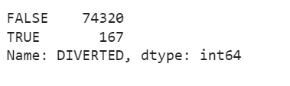

Flights Diverted
Total flights = 74487
% Flights Diverted = 0.22%

Slide 30
Thank You

